Slide 1
An Overview of Machine Learning
Speaker: Yi-Fan Chang
Adviser: Prof. J. J. Ding
Date: 2011/10/21

Slide 2
Outline & Content
What is machine learning?
Learning system model
Training and testing
Performance
Algorithms
Machine learning structure
What are we seeking?
Learning techniques
Applications
Conclusion

Slide 3
What is machine learning?
A branch of artificial intelligence, concerned with the design and development of algorithms that allow computers to evolve behaviors based on empirical data.
As intelligence requires knowledge, it is necessary for the computers to acquire knowledge.

Slide 4
Learning system model
Testing
Input Samples
Learning Method
System
Training

Slide 5
Training and testing
Data acquisition
Practical usage
Universal set
(unobserved)
Training set (observed)
Testing set
(unobserved)

Slide 6
Training and testing
Training is the process of making the system able to learn.
No free lunch rule:
Training set and testing set come from the same distribution
Need to make some assumptions or bias

Slide 7
Performance
There are several factors affecting the performance:
Types of training provided
The form and extent of any initial background knowledge
The type of feedback provided
The learning algorithms used
Two important factors:
Modeling
Optimization

Slide 8
Algorithms
The success of machine learning system also depends on the algorithms.
The algorithms control the search to find and build the knowledge structures.
The learning algorithms should extract useful information from training examples.

Slide 9


Algorithms
Supervised learning ( )
Prediction
Classification (discrete labels), Regression (real values)
Unsupervised learning ( )
Clustering
Probability distribution estimation
Finding association (in features)
Dimension reduction
Semi-supervised learning
Reinforcement learning
Decision making (robot, chess machine)

Slide 10
Algorithms
Supervised learning
Unsupervised learning
Semi-supervised learning

Slide 11
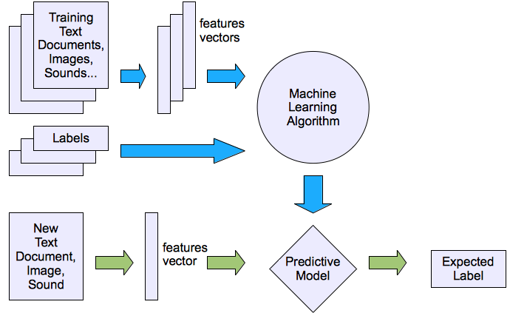
Machine learning structure
Supervised learning

Slide 12
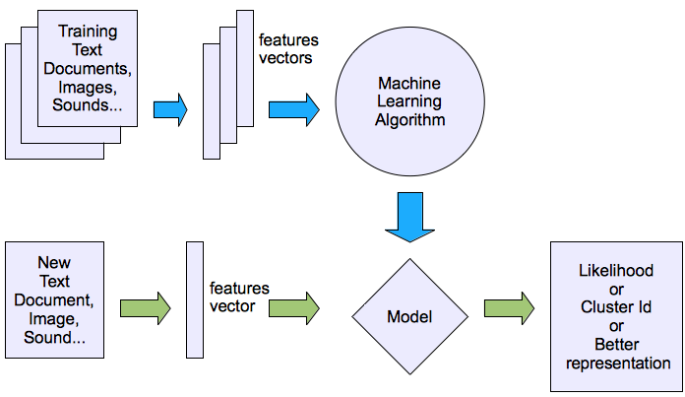
Machine learning structure
Unsupervised learning

Slide 13
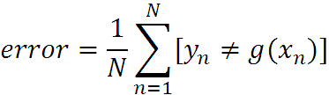
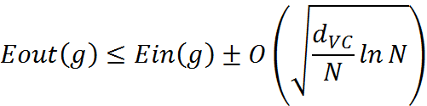
What are we seeking?
Supervised: Low E-out or maximize probabilistic terms
Unsupervised: Minimum quantization error, Minimum distance, MAP, MLE(maximum likelihood estimation)
E-in: for training set
E-out: for testing set

Slide 14




What are we seeking?
Under-fitting VS. Over-fitting (fixed N)
error
(model = hypothesis + loss functions)

Slide 15
Learning techniques
Supervised learning categories and techniques
Linear classifier (numerical functions)
Parametric (Probabilistic functions)
Naïve Bayes, Gaussian discriminant analysis (GDA), Hidden Markov models (HMM), Probabilistic graphical models
Non-parametric (Instance-based functions)
K-nearest neighbors, Kernel regression, Kernel density estimation, Local regression
Non-metric (Symbolic functions)
Classification and regression tree (CART), decision tree
Aggregation
Bagging (bootstrap + aggregation), Adaboost, Random forest

Slide 16

Learning techniques
Linear classifier
Techniques:
Perceptron
Logistic regression
Support vector machine (SVM)
Ada-line
Multi-layer perceptron (MLP)
, where w is an d-dim vector (learned)

Slide 17
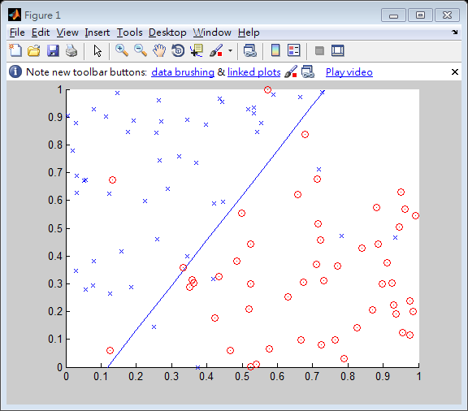
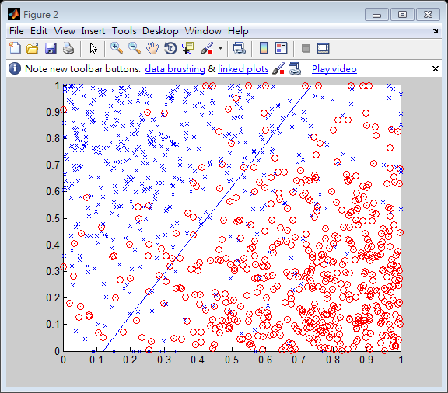
Learning techniques
Using perceptron learning algorithm(PLA)
Training
Testing
Error rate: 0.10
Error rate: 0.156

Slide 18
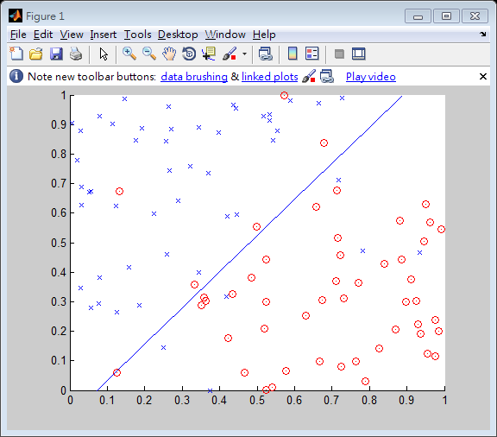
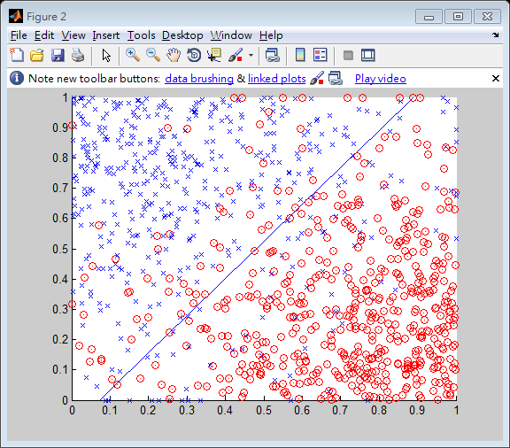
Learning techniques
Using logistic regression
Training
Testing
Error rate: 0.11
Error rate: 0.145

Slide 19



Learning techniques
Non-linear case
Support vector machine (SVM):
Linear to nonlinear: Feature transform and kernel function

Slide 20
Learning techniques
Unsupervised learning categories and techniques
Clustering
K-means clustering
Spectral clustering
Density Estimation
Gaussian mixture model (GMM)
Graphical models
Dimensionality reduction
Principal component analysis (PCA)
Factor analysis

Slide 21
Applications
Face detection
Object detection and recognition
Image segmentation
Multimedia event detection
Economical and commercial usage

Slide 22
Conclusion
We have a simple overview of some techniques and algorithms in machine learning. Furthermore, there are more and more techniques apply machine learning as a solution. In the future, machine learning will play an important role in our daily life.

Slide 23
Reference
[1] W. L. Chao, J. J. Ding, “Integrated Machine Learning Algorithms for Human Age Estimation”, NTU, 2011.

